Slide 1
FINAL PROJECTS
COMPUTER INFORMATION TECNOLOGY
CV RESUME
SPREAD SHEET
ANALISE

Slide 2
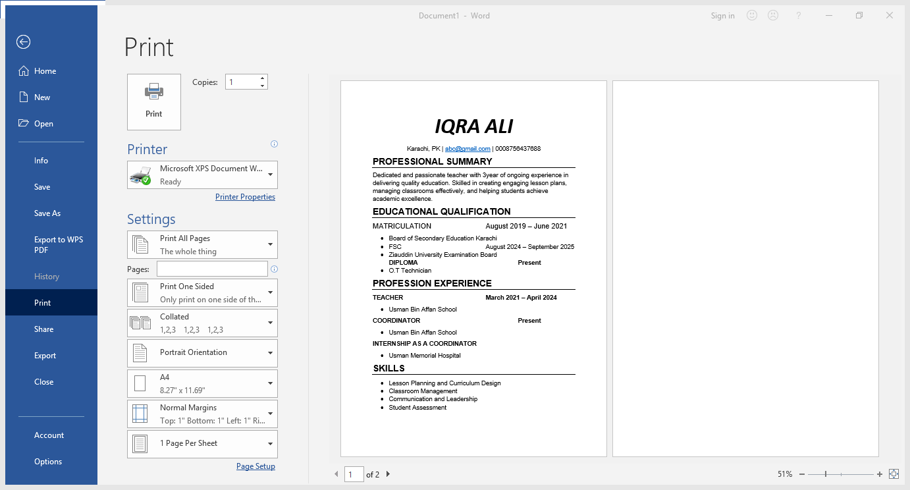
MY RESUME
Consists of five sections which includes my academic and professional details

Slide 3
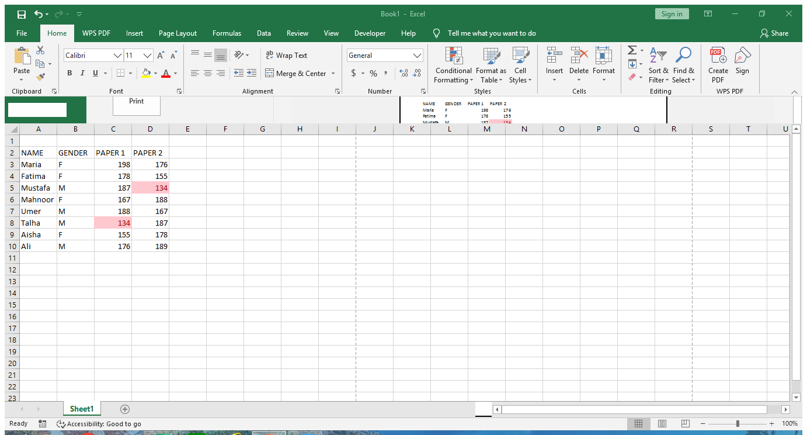
CONDITIONAL FORMATTING
IN EXCEL

Slide 4
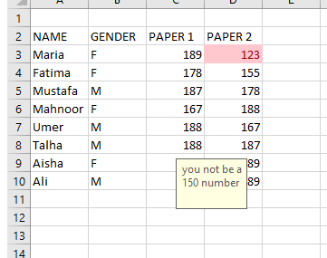
DATA VALIDATION
Here I have data validation and restricted to only enter a number between 100 to 150 and when he enters another number he gets an error

Slide 5
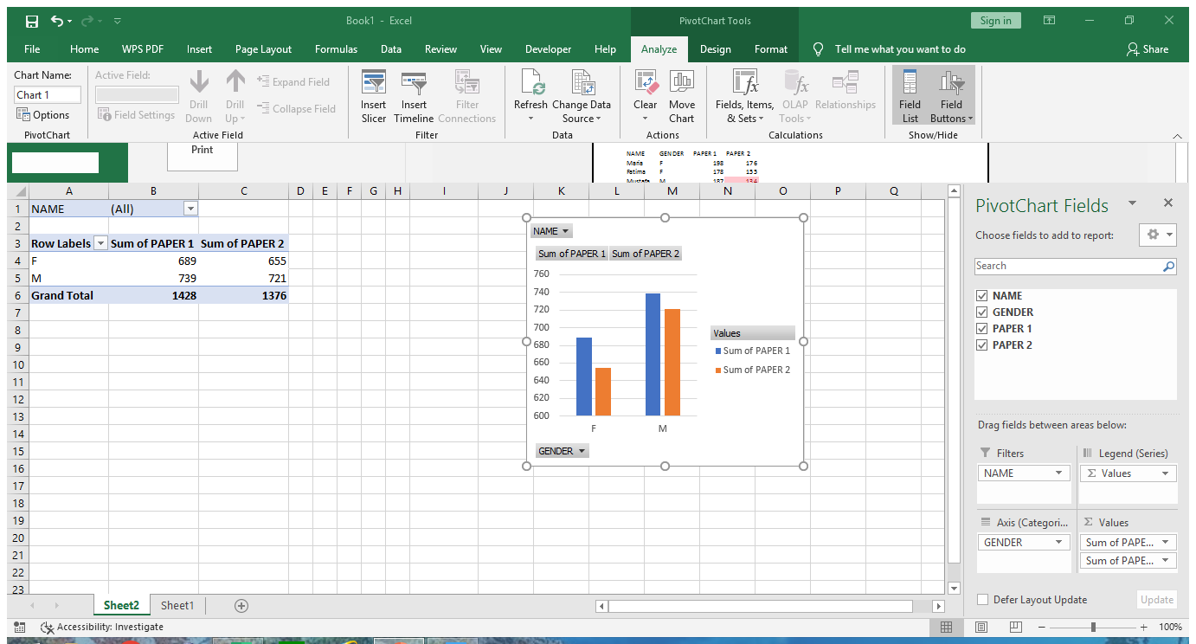
PIVOT TABLE IN EXCEL
I Have created a pivot table in excel to sort and filter my data

Slide 6
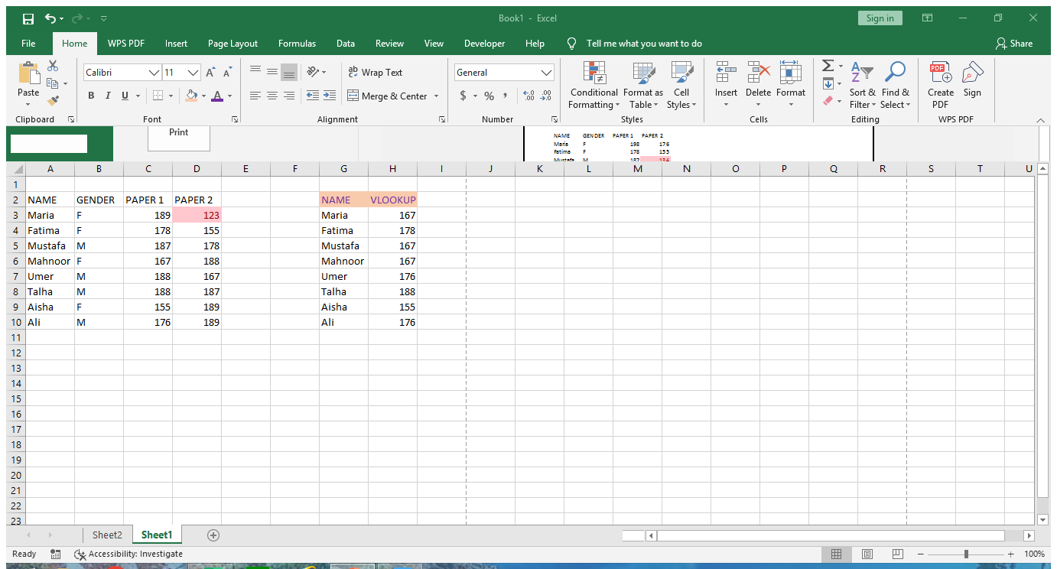
VLOOKUP IN EXCEL
VLOOKUP in excel is used to lookup a certain value in any column

Slide 7
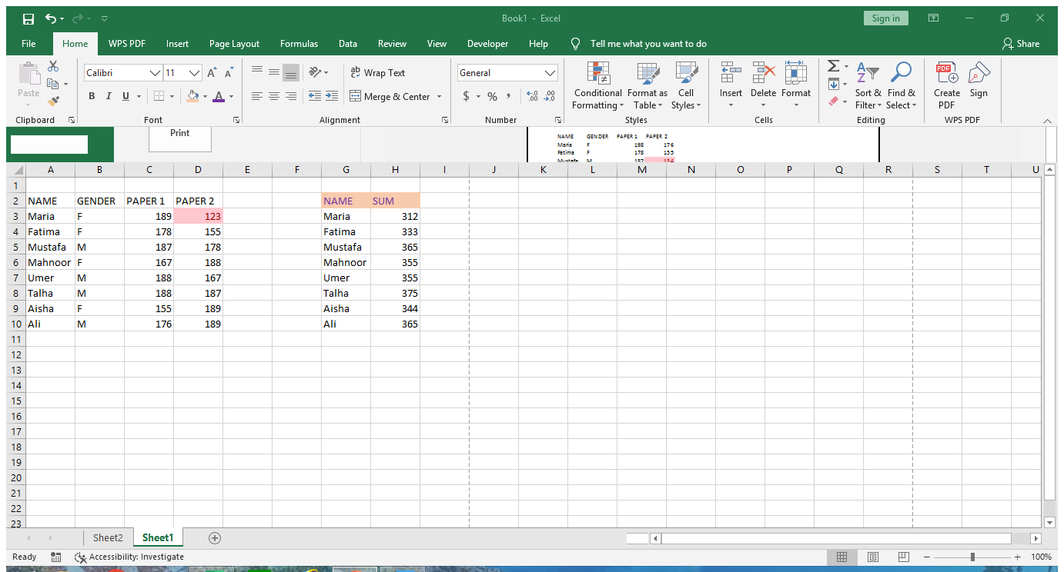
SUM IN EXCEL
SUM ADD TO NUMBER

